Slide 1
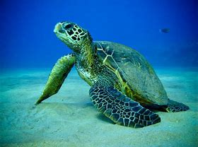
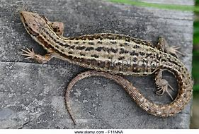
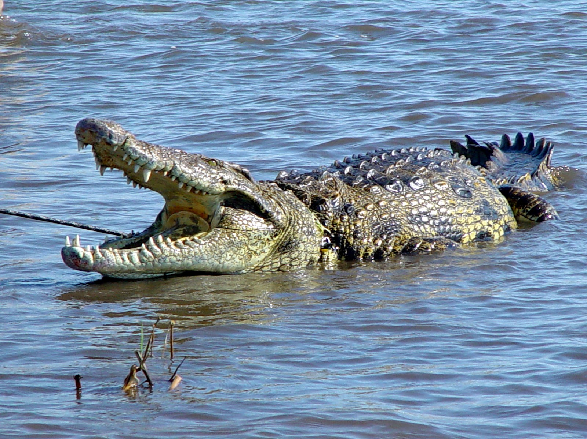
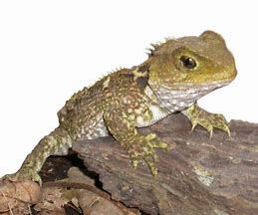
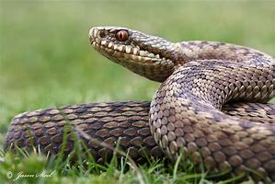
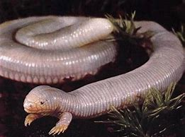
Reptiles and Habitats
Suzanne Collinson

Slide 2
reptiles
Snakes
Lizards
Differences
No legs
Overlapping scales
No ear openings
Forked tongue
No eyelids
Legs
Smooth scales
Ear openings
Blunt tongue
eyelids

Slide 3
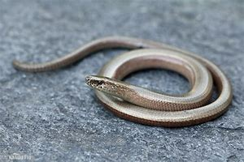
Snake or lizard ????
Slow worm
(Legless Lizard)

Slide 4
Slow worm facts
We like to live in long grass and burrow in loose soil
We are very quiet and secretive
We like to eat earthworms, slugs and snails
We are cold blooded endothermic so warm ourselves up by basking in the sun
We hibernate during winter
We can live up to 30 years old
We can grow to 50cm in length and are well camouflaged
If scared our tails drop off autonomy
Our population numbers are in decline and we are protected by wildlife laws

Slide 5
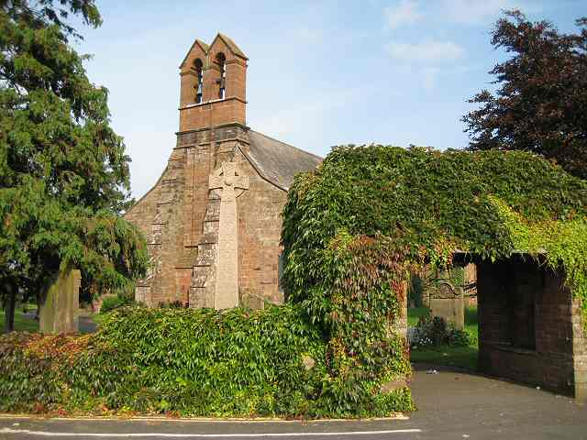
Dalston slow worms
They have lived in Dalston for over 60 years
They have a special area of habitat to live in at the churchyard

Slide 6
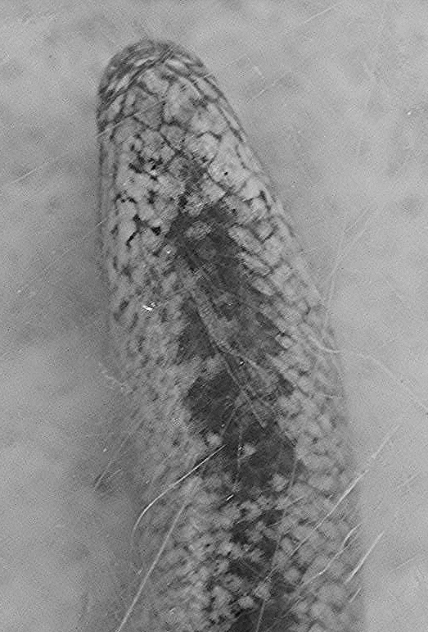
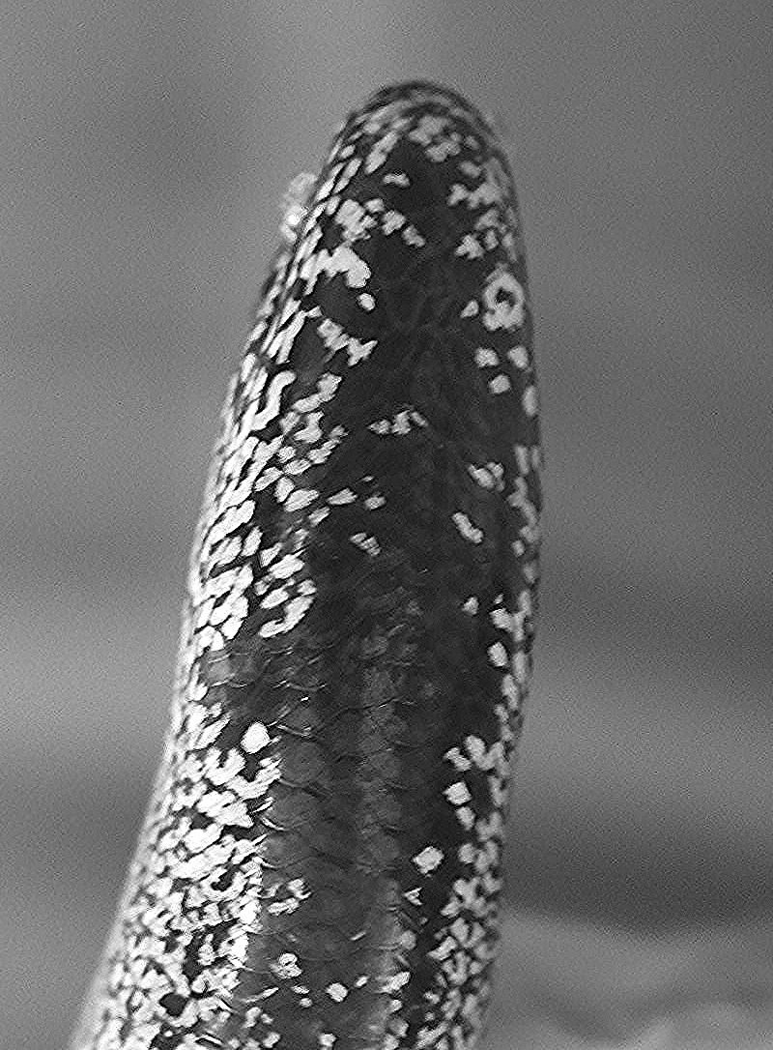
Slow worm study
I have been looking after the slow worms for two years
Photo of their chin patterns
They all have different patterns on their chins
I can identify individuals
I can use this information
Habitat they prefer
Who they like to hang out with
How far they move
This helps if they need to be moved to a new area or if numbers decline, so changes to their habitat can be made to help them

Slide 7
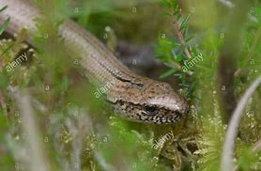
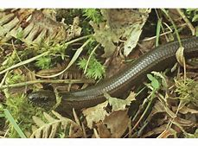
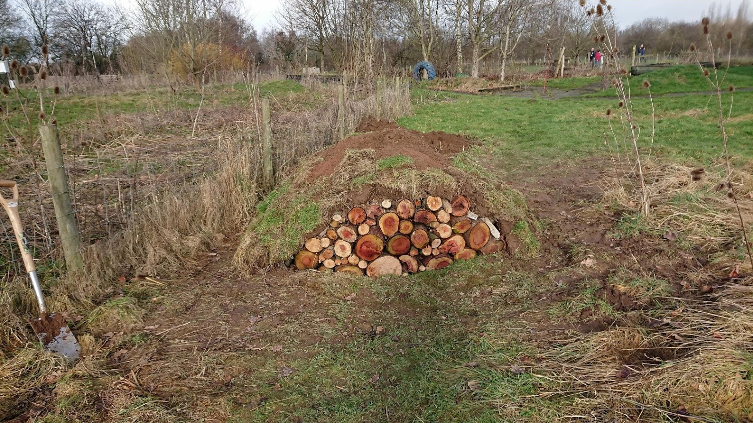
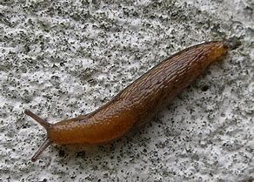
What do slow worms need to survive
AIR
WATER
FOOD
SHELTER
SPACE

